Slide 1

Passerelles numériques
A Gateway for Life
CRUD
Resource Controller

Slide 2
Outline
CRUD
Resource controller

Slide 3
CRUD on Post

Slide 4
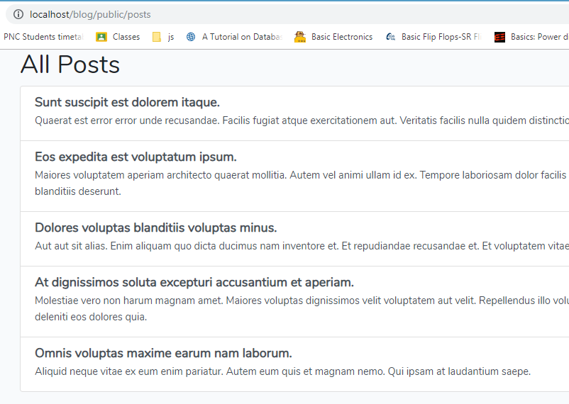
Get all posts
We have done it already from the previous activity to show all posts on the view

Slide 5
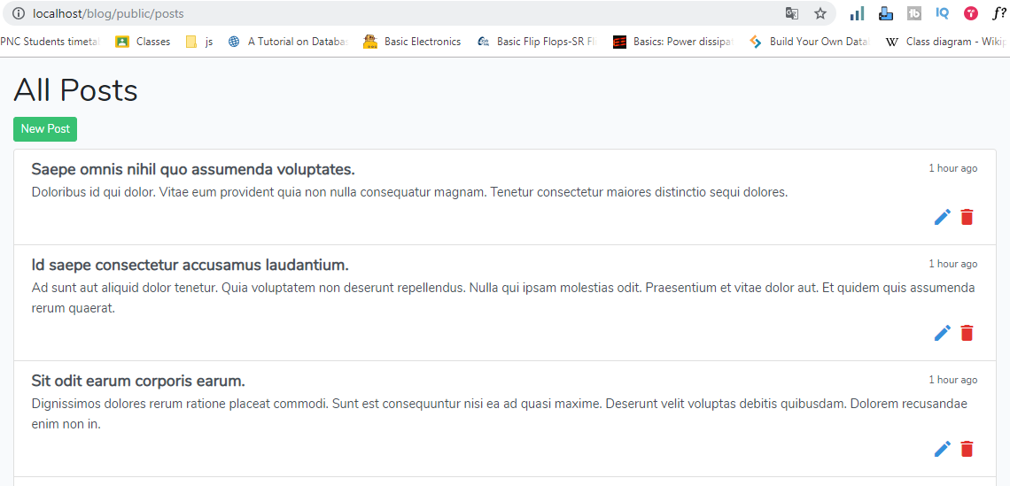
Activity#1:10mn
Try to add few more things
New post button, edit, delete and hour posted ago

Slide 6
Create Post

Slide 7
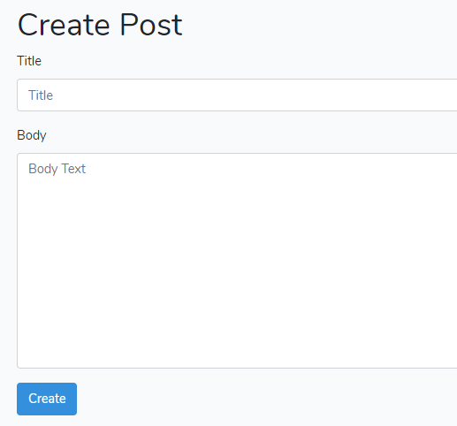
Create new Post
The flow: click on the new post button it will show the form for entering to create new post.

Slide 8
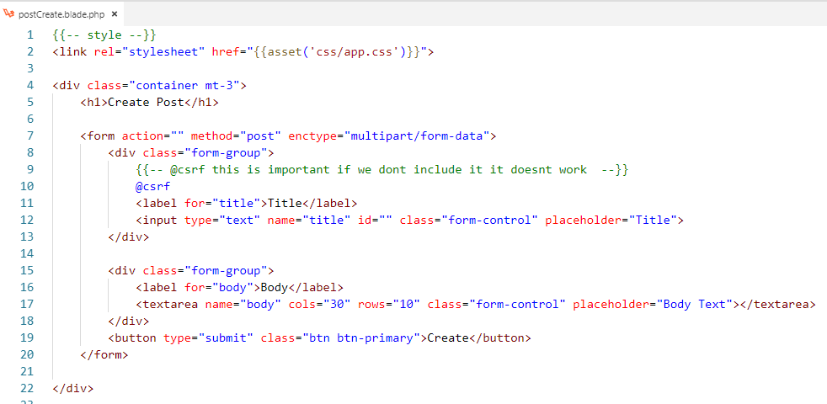
Create new Post
Step1: create view for creating post with form to enter title, body and button create

Slide 9


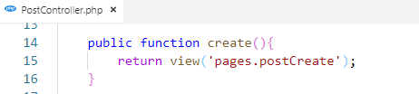
Create new Post
Step2: manage route to show the create post view
Add the route to New Post button/link
Manage create method in controller

Slide 11

Create new Post
Step3: manage another route to store or insert data into post table

Slide 12
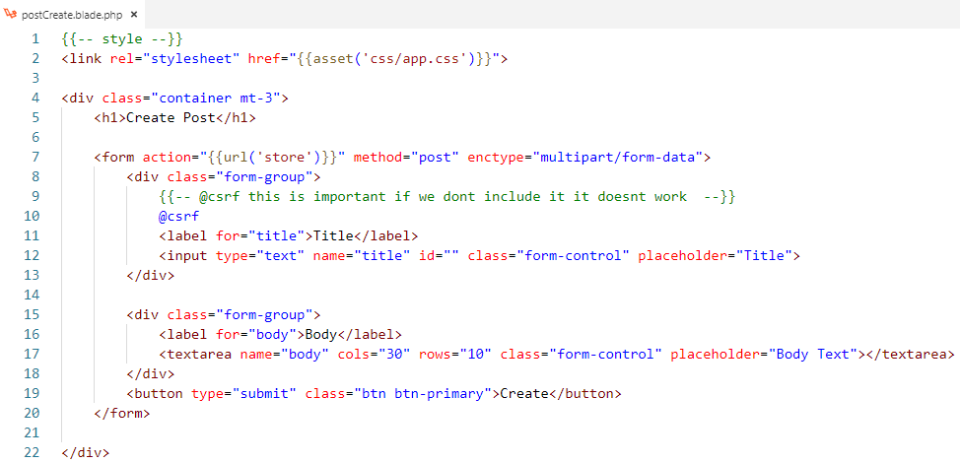
Create new Post
Step4: add the route controller to button Create

Slide 13
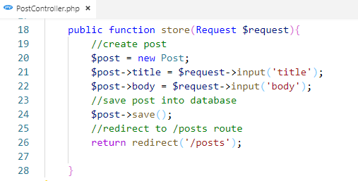
Create new Post
Step5: create the store method in controller to insert data from form into post table

Slide 14
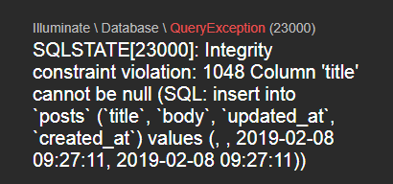
No Validation
If we click on the create button when there is no information input

Slide 15
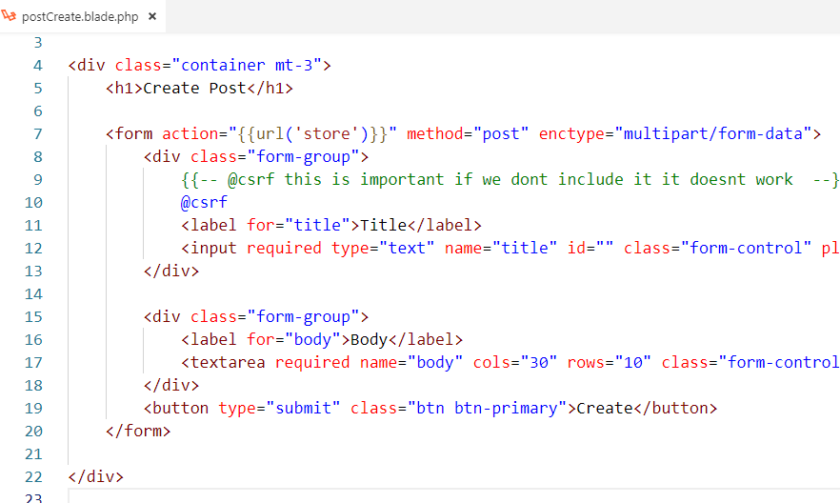
HTML Validation

Slide 16
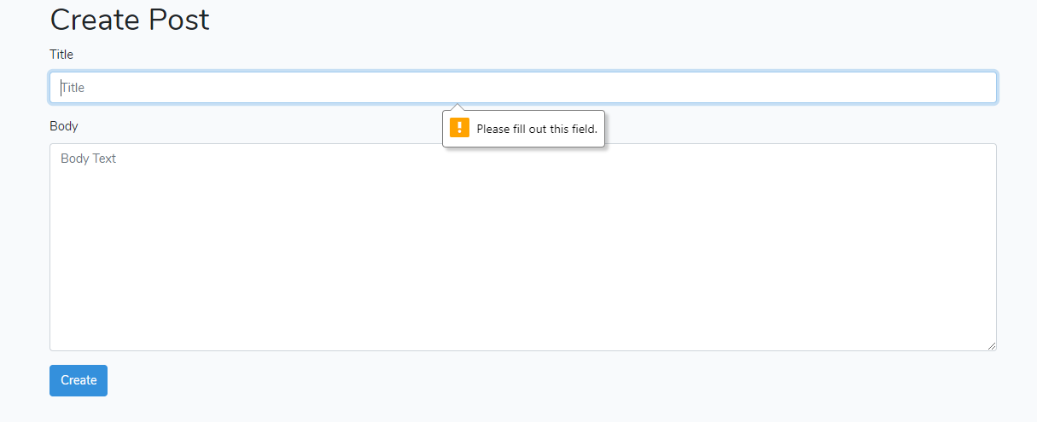
HTML Validation

Slide 17
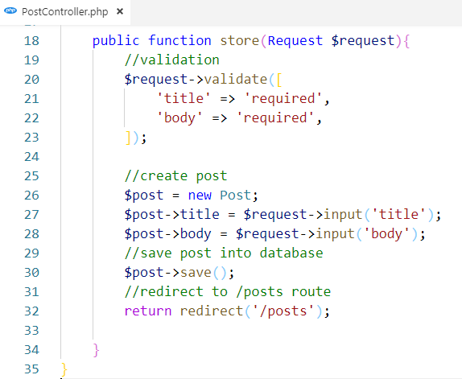
Validation with Laravel
https://laravel.com/docs/5.7/validation

Slide 18
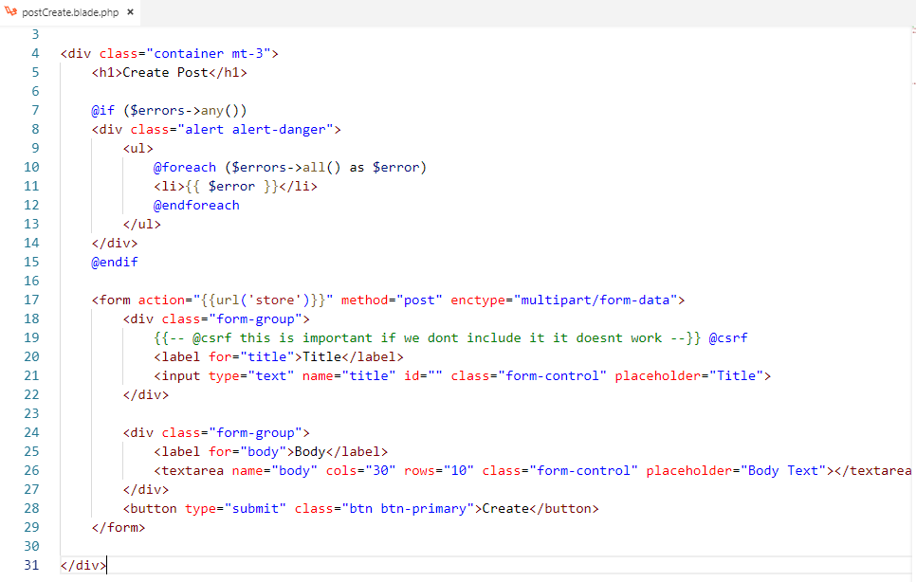
Displaying The Validation Errors

Slide 19
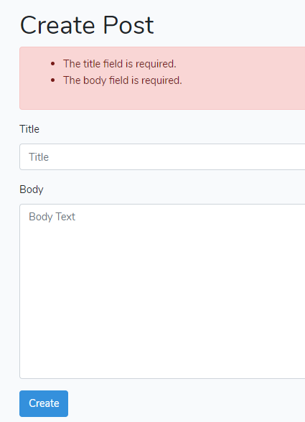

Slide 20
Edit Post

Slide 21
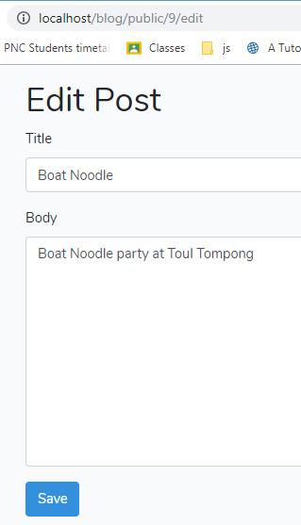
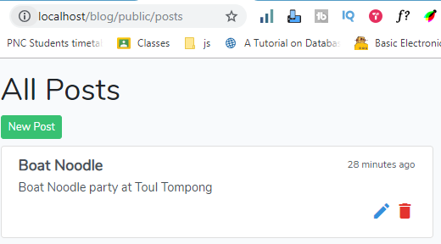
Edit post
Flow: when the pencil icon is clicked it will get all the information of that post (title,body,..) to display in another view with possibility to edit and save the post.

Slide 22
Edit post
Create postEdit view
{{-- style --}}
<link rel="stylesheet" href="{{asset('css/app.css')}}">
<div class="container mt-3">
<h1>Edit Post</h1>
<form action="" method="post" enctype="multipart/form-data">
<div class="form-group">
{{-- @csrf this is important if we dont include it it doesnt work --}}
@csrf
<label for="title">Title</label>
<input type="text" name="title" id="" class="form-control" placeholder="Title">
</div>
<div class="form-group">
<label for="body">Body</label>
<textarea name="body" cols="30" rows="10" class="form-control" placeholder="Body Text"></textarea>
</div>
<button type="submit" class="btn btn-primary">Save</button>
</form>
</div>

Slide 23
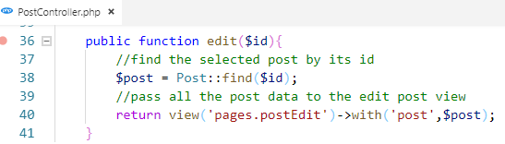
Edit post
Create method in controller to return all information from the selected post to the postEdit view

Slide 24

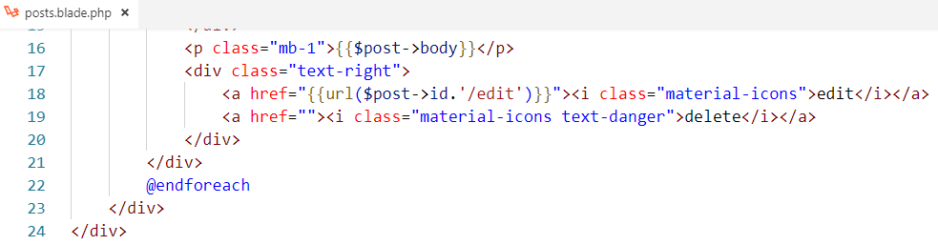
Edit post
Prepare the route for showing postEdit view when the pencil icon is clicked
Add this route url to pencil link

Slide 25
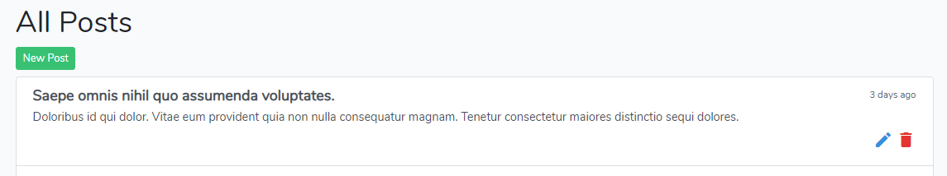
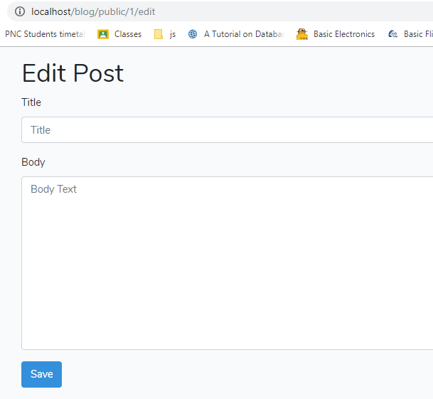
Edit post

Slide 26
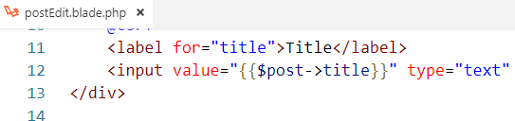

Edit post
Add the post information into the fields

Slide 27
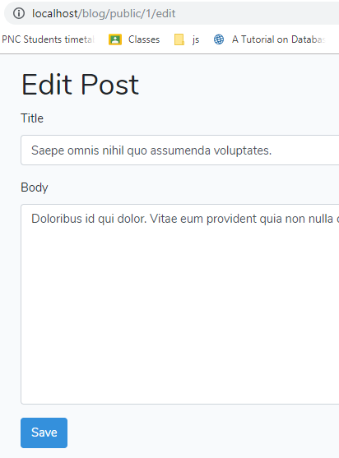
Edit post

Slide 28
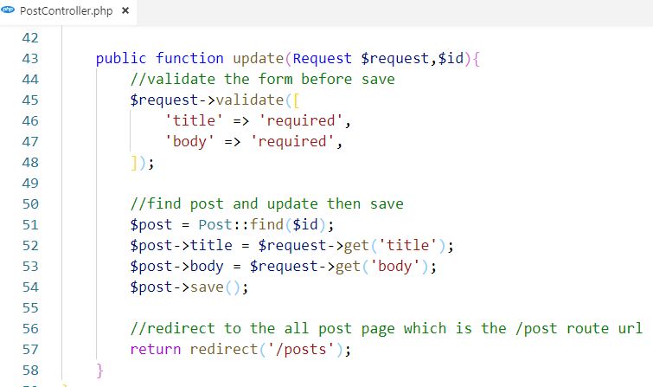
Edit post
Save post
Create a method to update the post in the controller

Slide 29

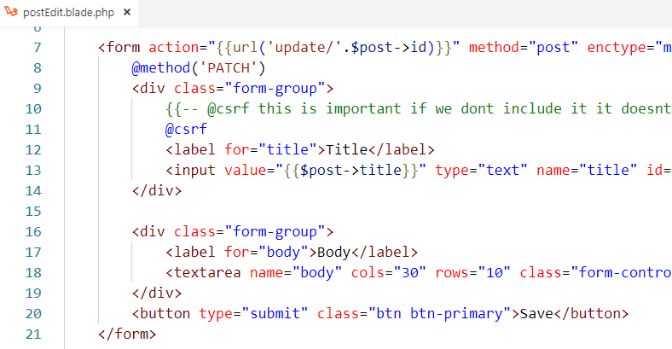
Edit post
Save post
Prepare the route and use it in the save button on edit post view

Slide 30
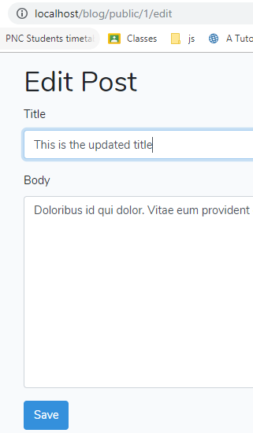
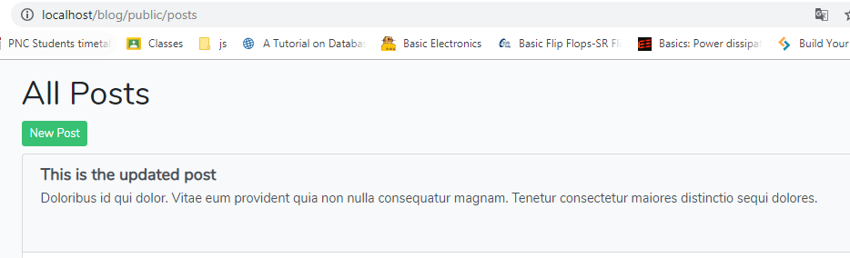
Edit post

Slide 31
Delete Post

Slide 32
Delete Post
The flow: when the trash icon is clicked then display the modal for confirmation to delete.

Slide 33

Delete Post
Prepare route

Slide 34
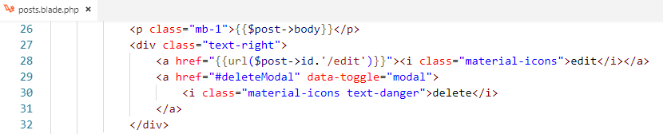
Delete Post
Click the trash icon to show the modal
https://getbootstrap.com/docs/4.0/components/modal/

Slide 35
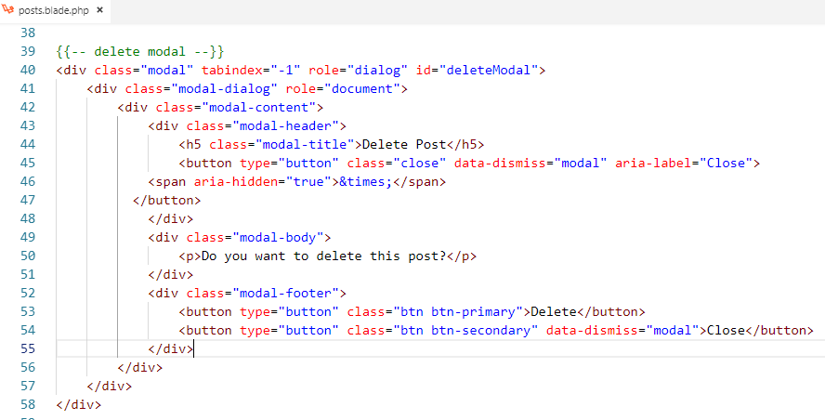
Delete Post
Add delete modal

Slide 36
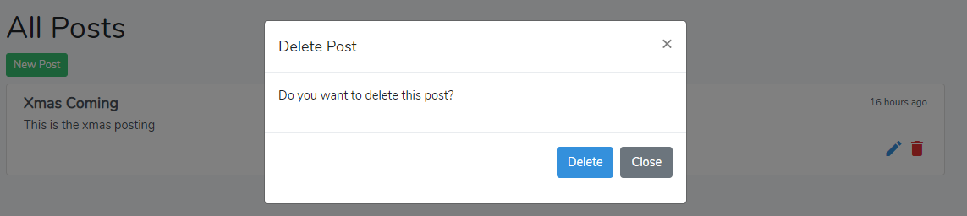

Slide 37
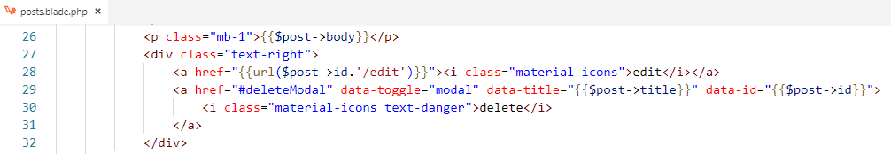
Delete Post
Add data on trash icon and send it to modal when it open

Slide 38
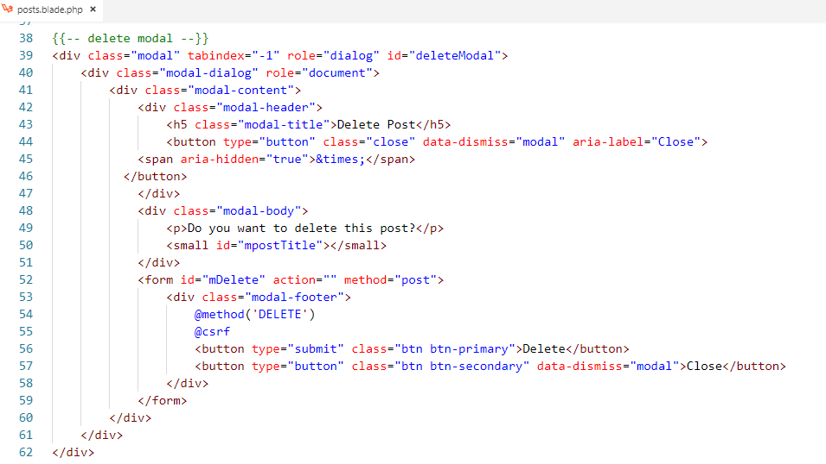
Delete Post
Add submit action to the modal

Slide 39
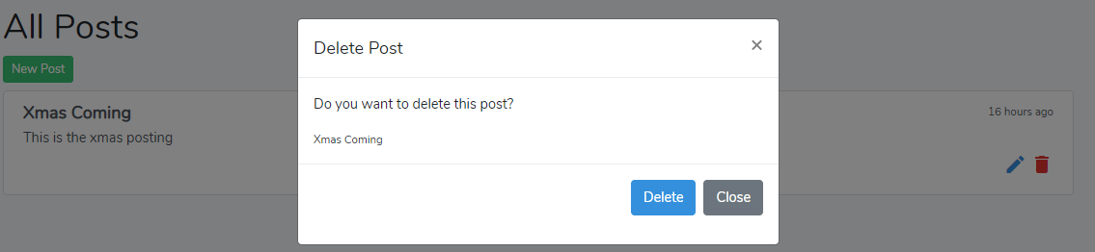

Slide 40
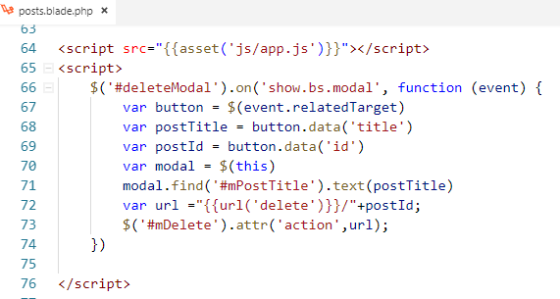
Delete Post
Add Javascript to send all data and handle the submit event

Slide 41
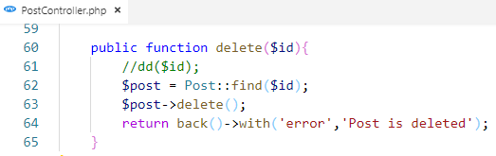
Delete Post
Add implementation into method delete in controller

Slide 42
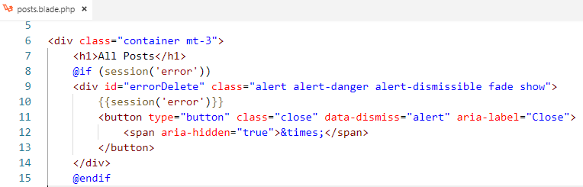
Delete Post
Add session message into post view

Slide 43
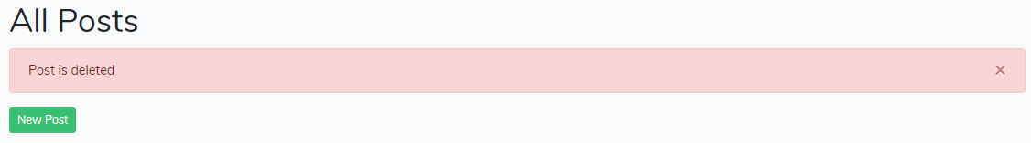

Slide 44
Resource Controller

Slide 45
Resource Controller
Laravel resource routing assigns the typical "CRUD" routes to a controller with a single line of code.
By generating the controller with resource, we don’t need to create individual route to handle all the CRUD action manually by ourselves.

Slide 46
Create resource controller
Create controller with resource
php artisan make:controller controllerName --resource

Slide 47
Example
Create CommentController with resource

Slide 48

Prepare route in web.php
Route::resource(‘comments’, ‘CommentController’);

Slide 49
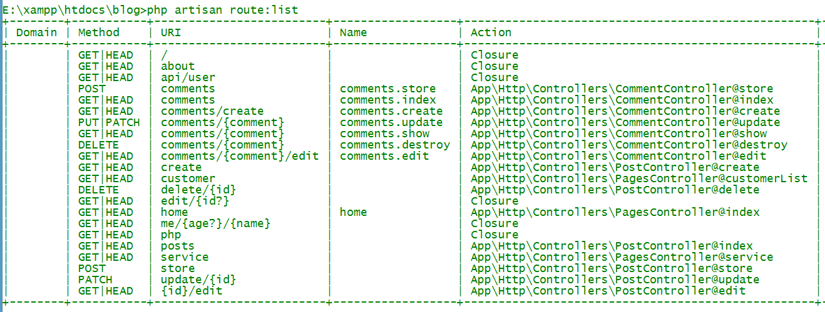
Show all route
php artisan route:list

Slide 50
Activity:45mn
Let’s do CRUD on comment by using the resource controller

Slide 51

Question?
Google.com

